Slide 1
Pharmacy Desert Risk Prediction Using Machine Learning
Sriram Devaraju
Regis University
MSDS692 Practicum-I

Slide 2
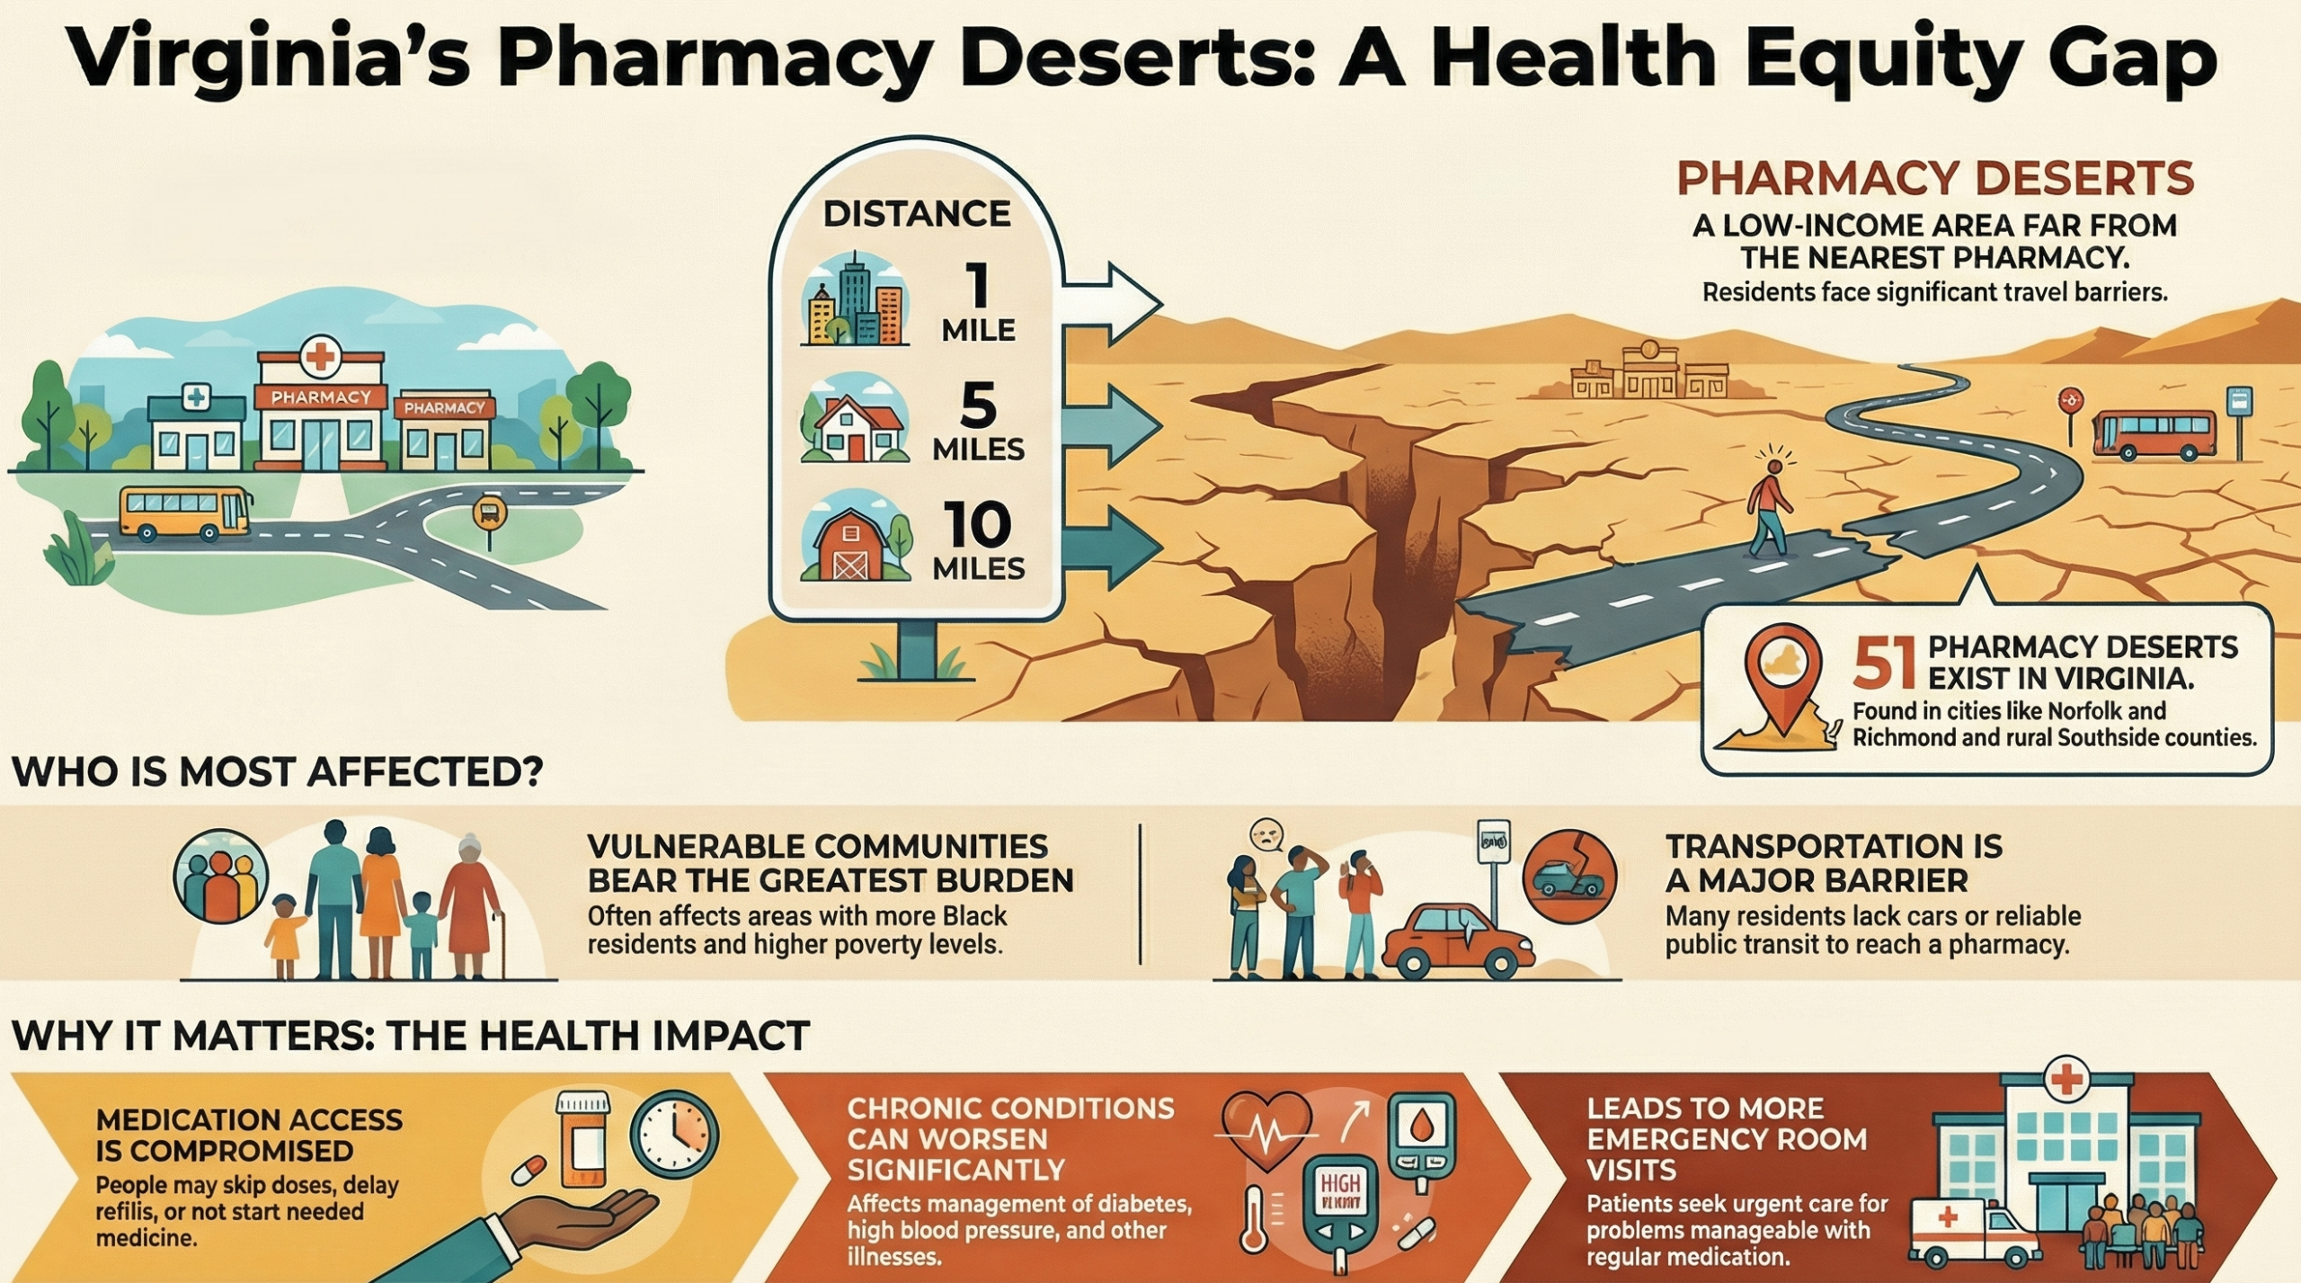
INTRODUCTION
Pharmacy deserts limits medication access.
Low pharmacy counties experience high access pressure
Populations face burden managing chronic diseases
Risk modeling for counties identifies where the pharmacy deserts occur .

Slide 3
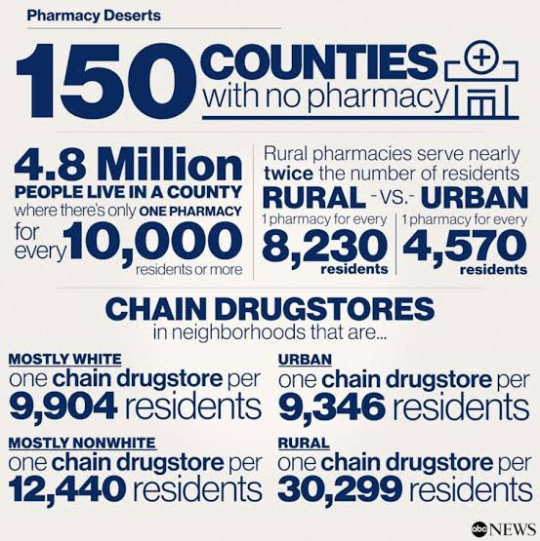
PROBLEM STATEMENT
Pharmacy access pressure changes across the county over the time .
Early detecting high-risk counties are difficult.
Traditional methods miss spatial-temporal patterns.
Goal : binary classification of counties as Low-risk or High-risk.

Slide 4
DATA COLLECTION
Data Source | Variables Used | Purpose
CMS Medicare Part D | ZIP, claims, drug cost, beneficiaries | Pharmacy utilization data
County Health Rankings | Health outcome and factor ranks | County health context
USDA ERS | Employment, labor force, unemployment | County economic context
ZIP–County Crosswalk | ZIP-to-FIPS mapping | County-level conversion

Slide 5
Data Preprocessing and Cleaning
Raw Input
Cleaning and Integration
Final Dataset
Used DuckDB to aggregate large CMS data.
Mapped ZIP-level records to county FIPS.
Aggregated data to county-year level.
Merged pharmacy, health, and economic features.
Converted “NR” values to NaN.
Removed 5 fully missing columns.
Imputed 124 USDA missing values
CMS Medicare Part D
County Health Rankings
USDA ERS
ZIP–County Crosswalk
25,324 records
County-year format
Ready for model training

Slide 6
Feature Engineering
PAP Index
bene_per_pharmacy_PAP
Beneficiaries ÷ pharmacies
TDF Feature access_pressure_change_TDF Yearly % change in PAP
Risk Label Desert_Formation_Risk ≥25% increase = High Risk <25% increase = Low Risk
Pharmacy Count
pharmacy_per_county_year
Unique pharmacies per county-year
TDF Interpretation:
• Negative = access improved
• Near zero = stable access
• Positive = access worsened
• ≥25% PAP increase = High Risk

Slide 7
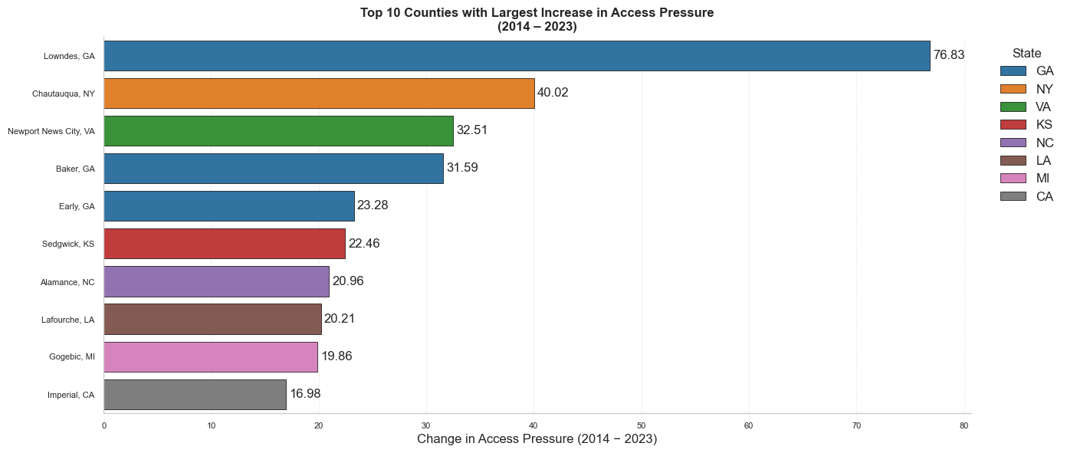
Exploratory Data Analysis
Access pressure varies across counties
PAP increased sharply in selected counties
Lowndes, GA had the largest increase
EDA confirmed county-level risk patterns

Slide 8
ML MODELS
Tabular baseline: XGBoost
Temporal modeling: LSTM
Spatial-temporal modeling: ST-GNN
Higher-order network modeling: HGNN
Feature interaction modeling: Tensor Train

Slide 9
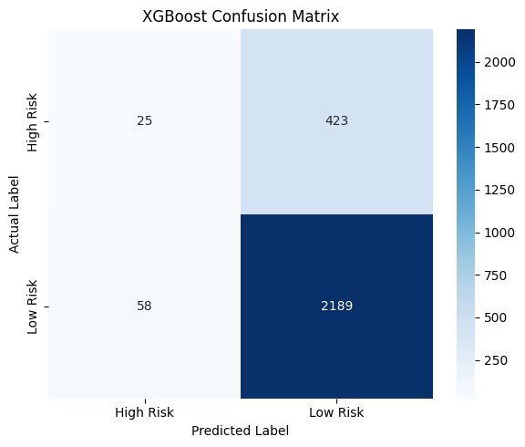
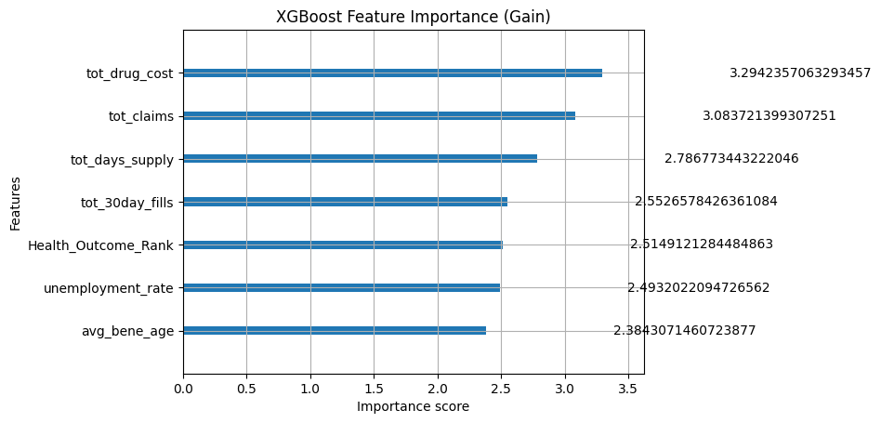
XGBoost Modeling
Input: County-year features
Model: XGBoost classifier
Output: High Risk / Low Risk
Results Accuracy: 0.82 Precision: 0.75 Recall: 0.82 Weighted F1-score: 0.77
Observation Best practical baseline Strong Low-Risk prediction High-Risk detection is limited

Slide 10
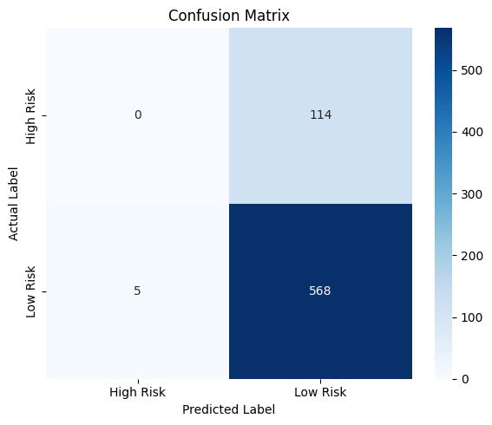
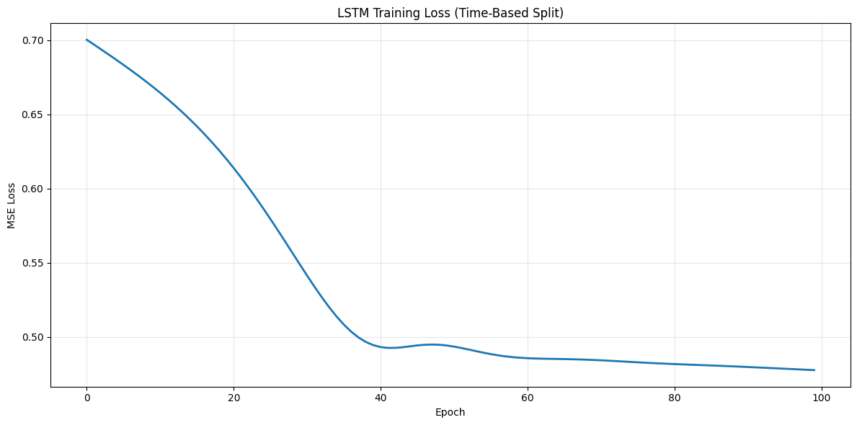
LSTM Temporal Model
Input: 2-year county sequences
Architecture:
2 LSTM layers ,64 hidden units, fully connected output layer
Results
Accuracy: 0.83
Precision: 0.64
Recall: 0.83
Weighted F1-score: 0.75
Observation
Temporal patterns learned
Loss decreased smoothly
High-Risk recall = 0.00

Slide 11
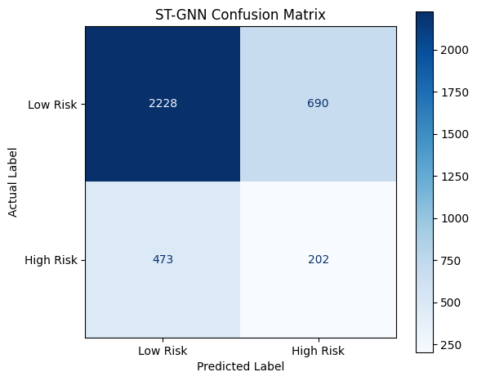
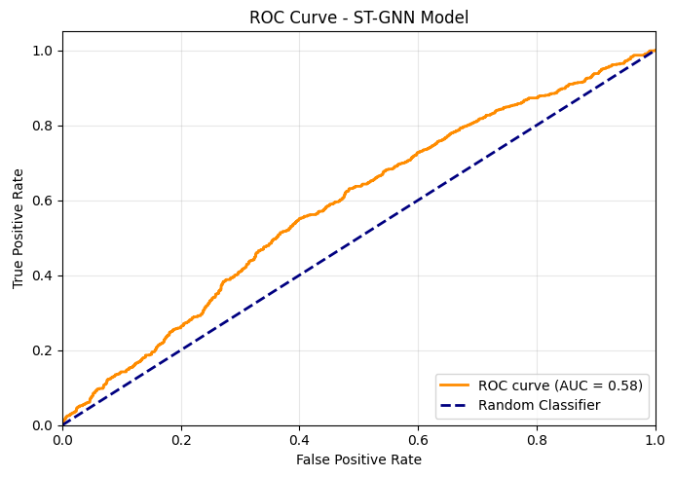
ST-GNN Model
Input: Spatial-temporal features
Model: ST-GNN classifier
Output: High Risk / Low Risk
Results
Accuracy: 0.72
Precision: 0.26
Recall: 0.25
F1-score: 0.26
ROC-AUC: 0.58
Observation
Neighbor context added
Detected 202 High-Risk cases
Class separation remained weak

Slide 12
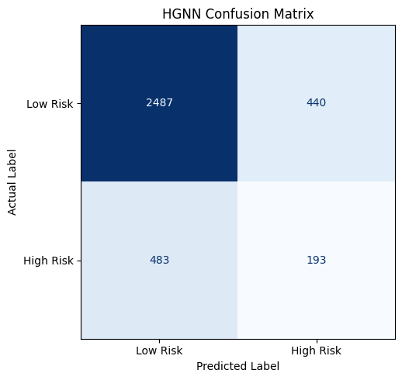
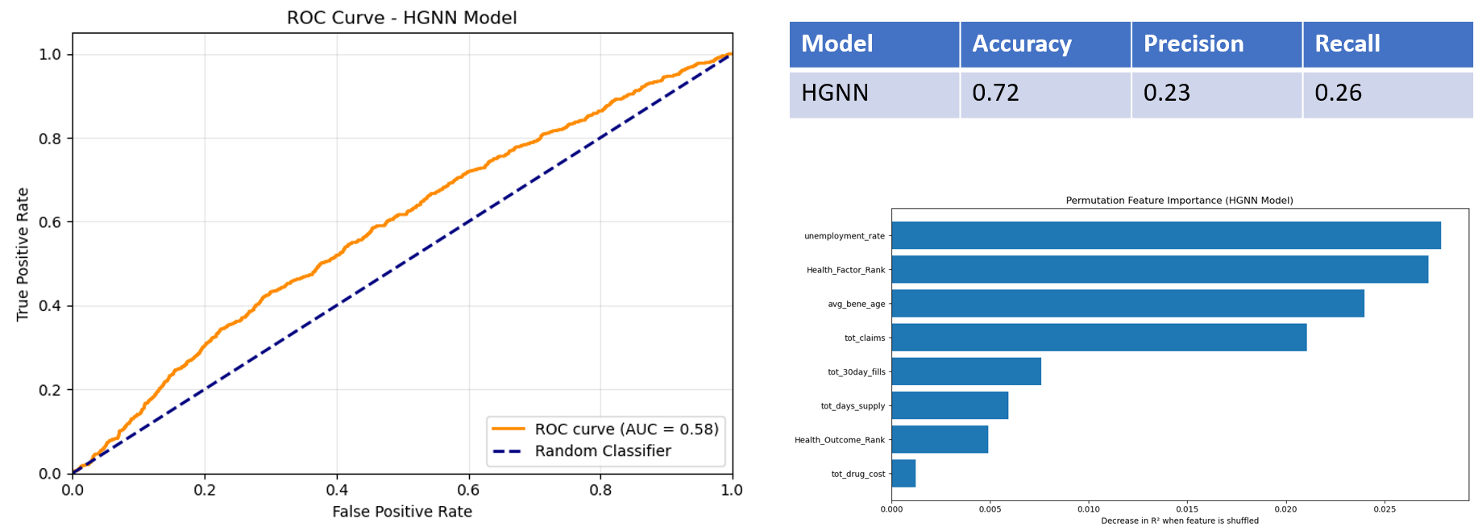
HGNN Modeling
Input: Higher-order county patterns
Model: HGNN classifier
Output: High Risk / Low Risk
Results
Accuracy: 0.72
Precision: 0.23
Recall: 0.26
F1-score: 0.29
ROC-AUC: 0.58
Observation
Higher-order patterns captured
Detected 193 High-Risk cases
Class separation improved slightly

Slide 13
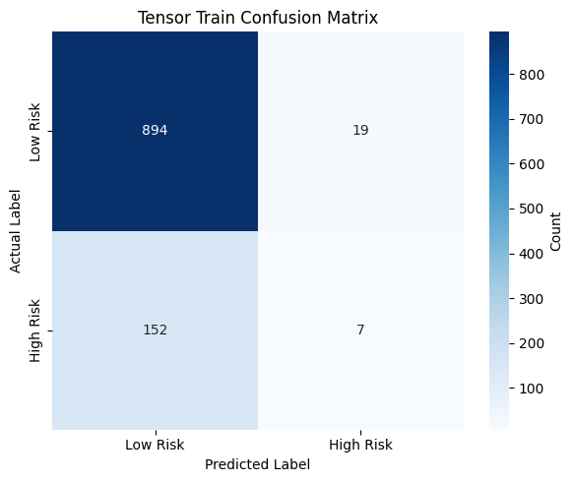
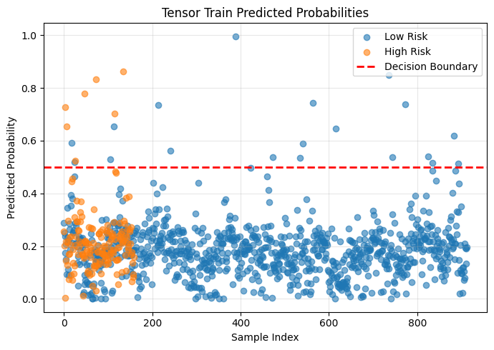
Tensor Train Network
Input: Feature interaction data
Model: Tensor Train classifier
Output: High Risk / Low Risk
Results
Accuracy: 0.84
Precision: 0.35
Recall: 0.06
F1-score: 0.08
Observation
Highest accuracy
Strong Low-Risk prediction
High-Risk recall very weak

Slide 14
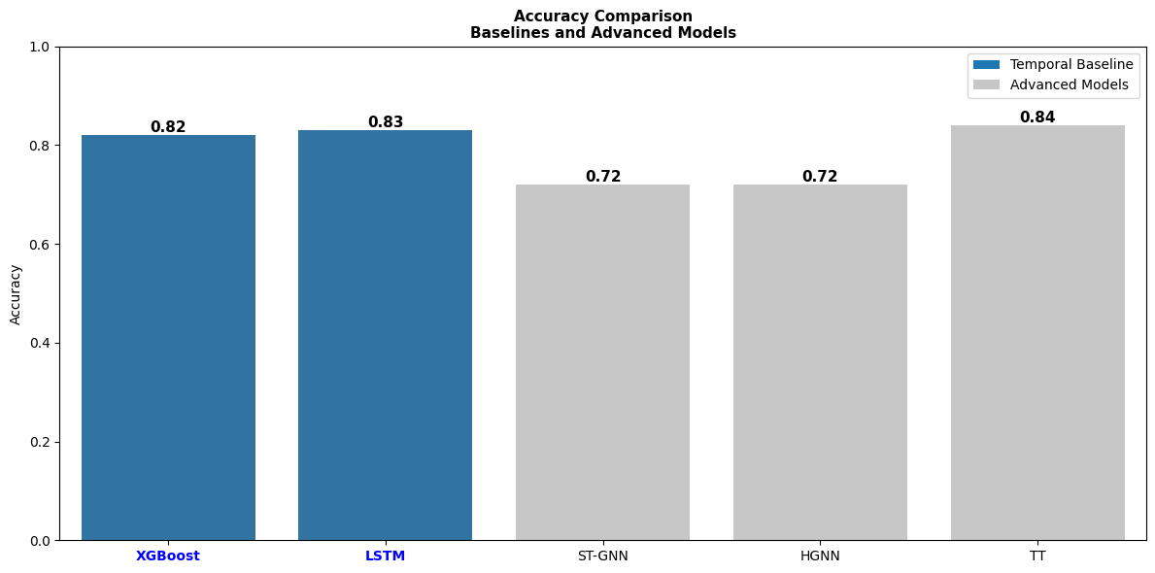
Baseline Comparison: XGBoost vs Advanced Models
Model | Accuracy | F1-score | Key Finding
XGBoost | 0.82 | 0.77 | Best practical baseline
LSTM | 0.83 | 0.75 | Missed High-Risk cases
ST-GNN | 0.72 | 0.26 | Detected 202 High-Risk cases
HGNN | 0.72 | 0.29 | Improved class separation
Tensor Train | 0.84 | 0.08 | High accuracy, weak recall
XGBoost was used as the baseline model.
Advanced models were compared against XGBoost.
Tensor Train had the highest accuracy but very low F1-score.
Accuracy alone was not enough because High-Risk recall was weak.
ST-GNN and HGNN captured spatial patterns but had weak precision/recall.
XGBoost remained the best practical baseline due to balanced performance and interpretability.

Slide 15
Findings
PAP measured beneficiary load per pharmacy
TDF captured yearly access-pressure change
XGBoost gave the most practical performance
LSTM learned temporal trends but missed High Risk
ST-GNN and HGNN improved High-Risk detection
Tensor Train had high accuracy but weak recall

Slide 16
Conclusion
Built a county-year pharmacy risk pipeline
Engineered PAP and TDF access-risk features
Compared tabular, temporal, spatial, and tensor models
XGBoost performed as the best practical baseline
Model supports early pharmacy desert risk monitoring
Final Outcome:
Machine learning can support proactive pharmacy access planning.

Slide 17
THANK YOU

